Slide 1
Peter F Hughes ©
Legal Studies 2014
LOYOLA COLLEGE
UNIT 3
CHAPTER FOUR – Beazer Justice and Outcomes
PART A The Protection of Rights

Slide 2
Rights
Right – interest protected by law, respect for which is duty and disregard for which is a wrong…
Australia – legislation and common law protects our rights
USA – Their constitution contains a bill of rights

Slide 3
Express Rights
Contained in a Constitution
Normally changed by referendum eg Indigenous voting rights (Aust)
USA, Canada and Australia

Slide 4
Statutory Rights
Contained in a Bill of Rights
Bill = a Statute or law
Parliament can amend these laws regarding rights by changing them (repeal)
Statutory rights are not contained in a Constitution.

Slide 5
Statutory Rights
Courts cannot override the statutory rights that are legislated by Parliament.
In this case Parliament is the Supreme law making authority
NZ, Victoria and ACT

Slide 6
Rights protected by legislation and common law
No bill of rights
Australia has Human rights that are protected by legislation and common law.
Eg Equal Opportunity Act, Racial Discrimination Act
Australia

Slide 7
The protection of Rights
Due Consideration – what does this mean in relation to Constitutional Rights?
Due Consideration is the process parliament takes in altering / replacing / removing a Right that is in their Bill of Rights.

Slide 8
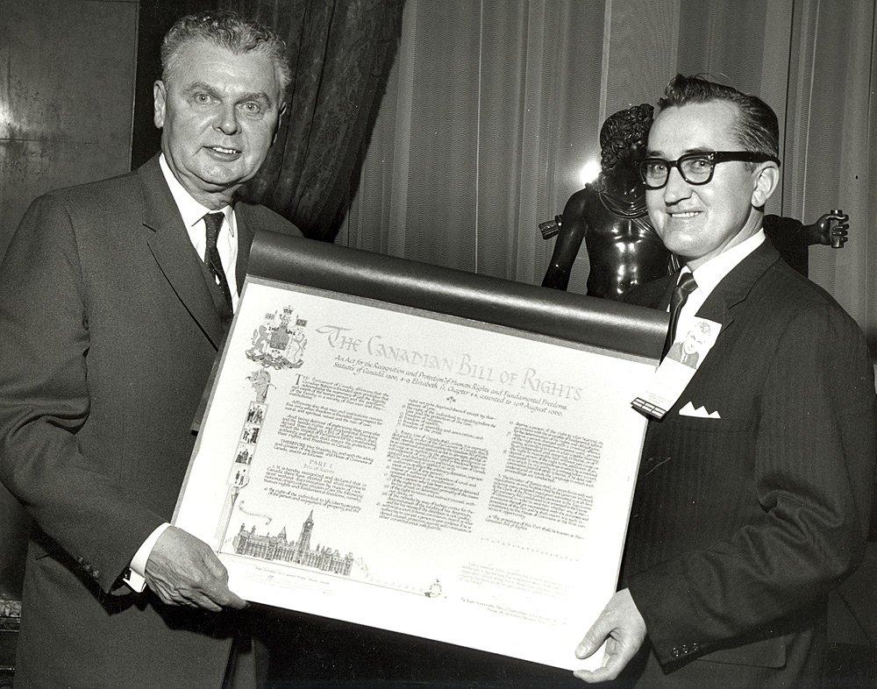
The Protection of Rights
Canada – Bill of Rights
Contains a Limitation Clause
Rights are subject to reasonable limits.
The limits are those that are demonstrably justified in a free and democratic society.

Slide 9
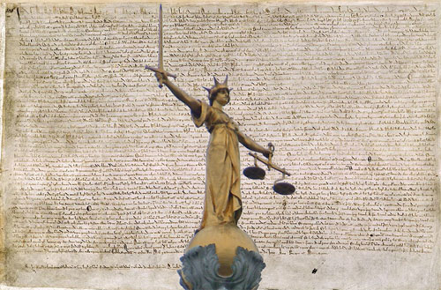
Enforcement
Bills of Rights
Interpretive Approach.
Watchdog Approach.
Complaints-based Approach.

Slide 10
INTERPRETIVE APPROACH
The court interprets if a law is compatible with the Bill of Rights.
Parliament takes advice of this interpretation.
Parliament can amend the law in relation to the protection or alteration of that right.

Slide 11
WATCHDOG APPROACH
Human rights organisations check that rights are not interfered with by Parliament.
Parliament accepts recommendations by these Human Rights bodies and alters laws appropriately.

Slide 12
COMPLAINTS-BASED APPROACH
Individuals, groups and organisations raise concerns with government.
This may be through a legal action in court.
High Court rules with a remedy.
The court ruling may interpret a law as being invalid in relation to a Bill of Rights.

Slide 13
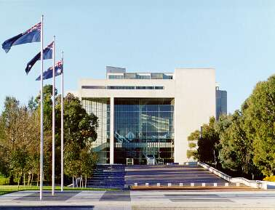
COMPLAINTS-BASED APPROACH
High Court of Australia

Slide 14
Australia – Constitutional Protection of Rights
Rights in Aust. are mainly protected by Legislation & Common Law.
Rights protected by the Constitution:
Structurally Protected Rights
Express Rights
Implied Rights

Slide 15
Rights covered by Structural Protection
Contained in the text of the Constitution.
Provides that mechanism which operates to protect rights.
Preventing abuse of power by the Commonwealth Parliament of the day.

Slide 16
Express Rights protected in the Constitution
Explicit rights that are ‘entrenched’ on the document.
Cannot be removed without a referendum.
Rights under common law and legislation by comparison can be removed by Parliament.

Slide 17
Express Rights protected in the Constitution
S116 Freedom of Religion
Prohibits the establishment of government approved religions.
Prohibits religious observances.

Slide 18
Express Rights protected in the Constitution
S92 Free Interstate Trade and Commerce.
Freedom of movement by traders between states (Border taxes etc)
Includes people
See Cole v Whitfield (1988)ALJR 303
The crayfish case (restriction of product acceptable providing it doesn’t impose a burden or restriction on State’s trade)

Slide 19
Express Rights protected in the Constitution
S117 Discrimination on basis of State (where you reside)
Unlawful for State and Commonwealth governments to discriminate on the residential address of people.
See r v Loubrie (1985) the bail case. Refused bail because he resided in another state – Ruling invalid under the Constitution

Slide 20
Express Rights protected in the Constitution
S51(xxxi) Acquisition of Property under just terms.
When Commonwealth acquires property from people compulsorily.
Decided by independent valuer (just terms)
Eg airports, state forest, desalination plants!!! See Minister Guy on that one.

Slide 21
Express Rights protected in the Constitution
S80 Trial by a Jury for indictable Commonwealth offences.
Limited because a lot of indictable offences are covered by the states.
See terrorism cases for relevance today

Slide 22
Implied Rights in the Constitution
Contained in the documents Structure and Text.
See the political freedom of communication case
Australian Capital Television v Commonwealth (1992)
High Court ruled that in the Constitution there is an implied right to freedom of political advertising (radio tv etc)

Slide 23
Enforcement of Rights in Australia
The High court interprets the Constitution in Constitutional cases.
Parliament cannot override this interpretation.
Parliament often has to change the legislation that is invalid (Malaysian solution for boat people)
Parliament can remove that right in the Constitution with a S128.

Slide 24
Homework or PL work
Today there is an focus on the protection of rights within the Australian Constitution.
The study design has an emphasis on ‘the extent to which human rights are protected by our Commonwealth Constitution.’
That includes both direct and indirect protection.

Slide 25
Homework or PL work
Once you have some notes on this emphasis of rights protection under the Constitution it needs to be compared with:
Another country
Can I suggest USA, Canada
See me for additional resources.

Slide 26
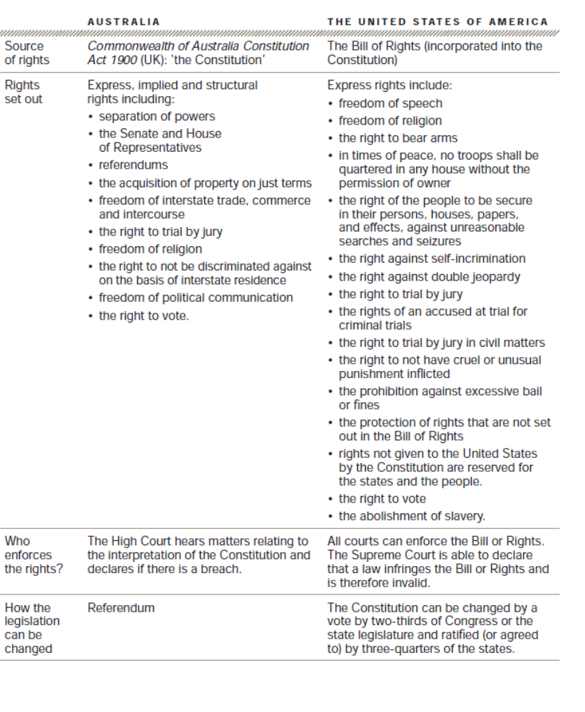

Slide 27
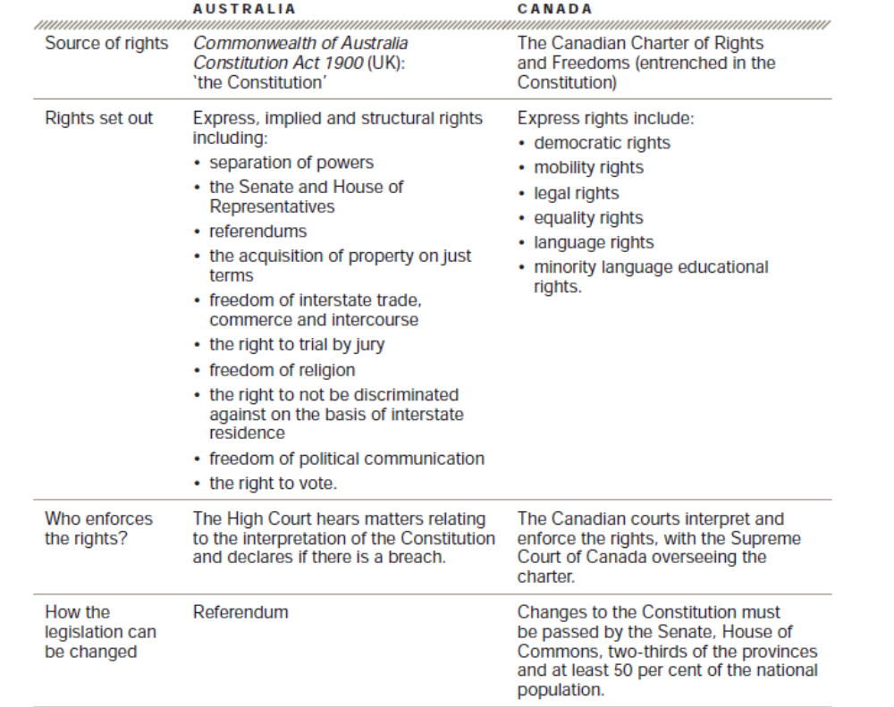

Slide 28
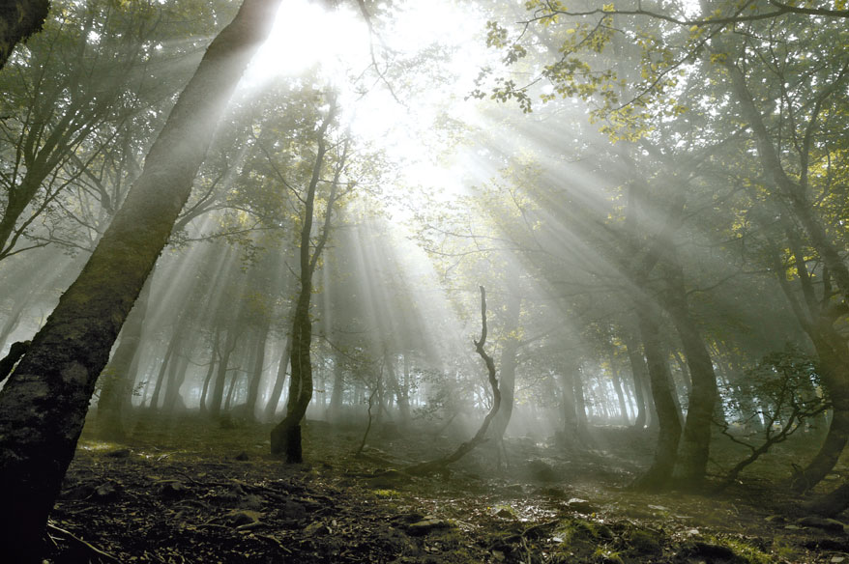
There is Light at the End – Keep working, Summarising & Note Taking.
Photo – Martin Thurheir (Daylesford) © 2010 Camino de Santiago

