Slide 1
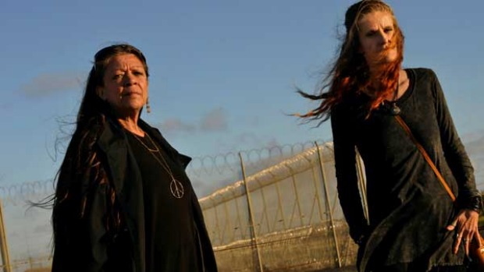
VCE Legal Studies 2016
The Constitution and the Protection of Rights Part 4
Case Law.

Slide 2
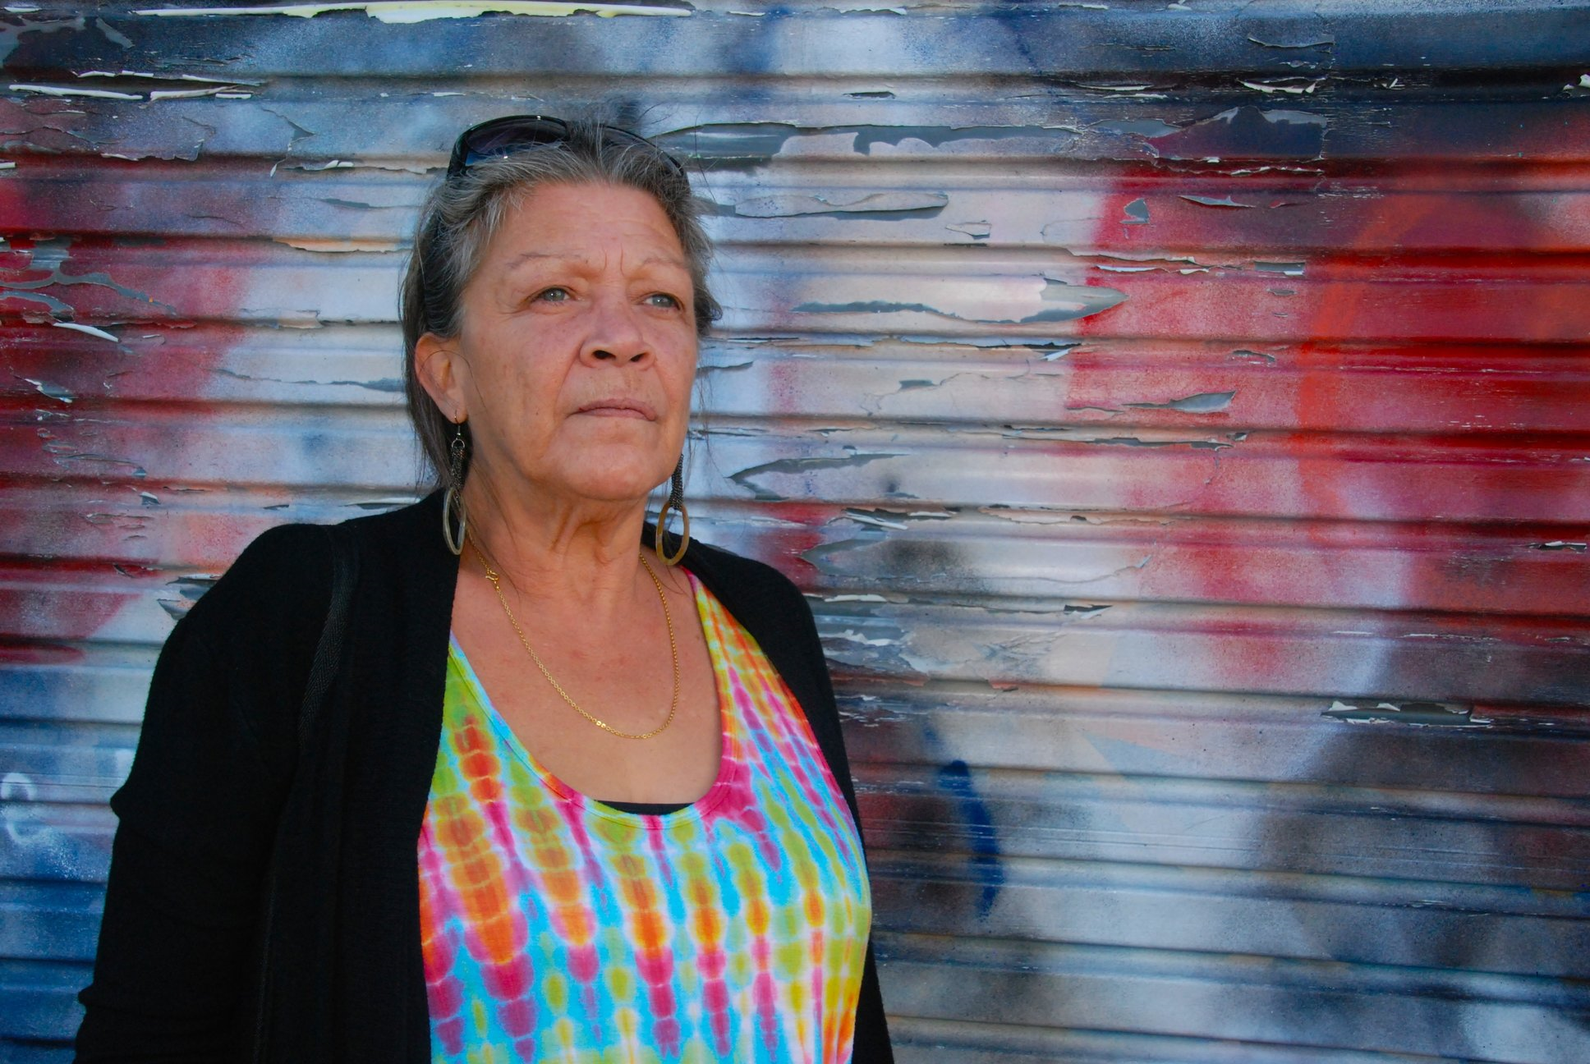
Roach v. Electoral Commissioner (2007) HCA 43
Background.
Vickie Roach, Writer, Yuin woman
Was in a violent relationship. Committed a crime (robbery)
Imprisoned
Her words, “When I went away that last time, things had already started to change for me,” Vickie says. “I started studying sociology philosophy and literature. I’ve always been an avid reader and had a strong sense of justice, and started talking with the community lawyers and activists who were coming into the jail.”

Slide 3
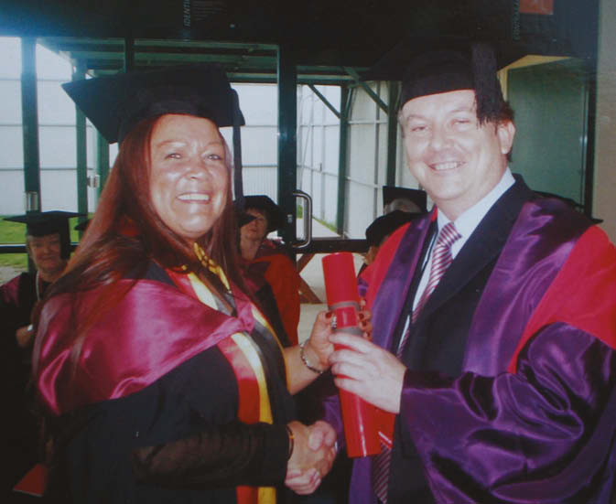
Roach v. Electoral Commissioner (2007) HCA 43
In 2007, Vickie was instrumental in a High Court challenge that struck out legislation banning prisoners who were serving three years or less from voting. Now 56 and on the other side of the law, Vickie is a passionate advocate for change in the criminal justice system.
Lets examine the case; Beazer Chapter 4

Slide 4
Roach v. Electoral Commissioner (2007) HCA 43
FACTS:
2006 Commonwealth Legislation prohibiting convicted and sentenced prisoners in Australia from voting in elections.
Vicki Roach was serving a 5 year sentence. She was still enrolled to vote in Kooyong, Victoria at this time.
Before the 2006 Commonwealth legislation, only prisoners serving sentences greater than 3 years were banned from voting. The new leghislation banned all prisoners from voting.
In 2007, Vicki Roach challenged the validity of the Commonwealth legislation in the High Court of Australia

Slide 5
Roach v. Electoral Commissioner (2007) HCA 43
Decision:
Found in favour of Roach
Reason for the decision:
2006 Commonwealth Electoral Acts were unconstitutional because they were not consistent with the system of representative democracy established by the Constitution.
These sections of the act prohibited all convicted and sentenced prisoners from voting in elections. Chief Justice Gleeson concluded that the words of S7 and S24 had come to grant a constitutional protection of the right to vote

Slide 6
Roach v. Electoral Commissioner (2007) HCA 43
Judges comments relevant for Implied Rights in our learning:
Chief Justice Gleeson stated that the right to vote could be removed for serious criminal misconduct, but not removed for prisoners who had been sentenced for less culpable criminal offences.
This implied that prisoners serving sentences for less serious crimes should be allowed to vote.
2004 legislation banning prisoners who were serving sentences longer than 3 years was valid.

Slide 7
The exam – which case to use??
In a short answer question, the Lange case will generally be the logical choice.
Where the question is greater than 3 marks, Roach would enable you to explain how this implied right (to vote) has come about.
The Strategy:
Summarise and study both cases. They are not complicated.
Use them in practice questions and see which case fits the best.

Slide 8
Past question – 10 marker
Question 13 2012 10 Marks
‘Rights in Australia are well protected by the Commonwealth Constitution, in part because of section 128 of the Constitution.’
Discuss the extent to which you agree or disagree with the above statement. In your answer, explain the significance of one High Court case that you have studied related to the constitutional protection of rights in Australia.
Hughes:
In my opinion this is a good question. In a paper worth 70 marks, here is an opportunity to really show the assessor your content knowledge and writing skills.
Why? In Outcome 2A we studies the constitution and referendums. In Outcome 2B we focus on the Constitution and how it protects our rights.

Slide 9
Question 13 2012 10 Marks
‘Rights in Australia are well protected by the Commonwealth Constitution, in part because of section 128 of the Constitution.’
Discuss the extent to which you agree or disagree with the above statement. In your answer, explain the significance of one High Court case that you have studied related to the constitutional protection of rights in Australia.
Which case? Its obvious, use Roach.
Examiners comments;
To gain full marks, the following aspects needed to be covered.
• an indication of the extent to which the student agreed or disagreed with the statement
• discussion of the protection of rights by the Commonwealth Constitution, and in particular whether or not they are well protected.
• whether or not section 128 protects rights in Australia
• an explanation of the significance of one High Court case related to the constitution protection of rights

Slide 10
Examiners comments
Stronger students used paragraphs to structure their answer, explained the significance of a High Court case and methodically discussed the protection of rights in Australia, as well as the role of section 128 in that protection, providing both strengths and weaknesses to that protection.
It was pleasing to see that many students understood what was required for this question. For example, stronger students did not go through the section 128 process as this was not required; many students identified the three types of protection (structural, implied rights, express rights) in their response.
Hughes: This would make an ideal SAC extended response question!

Slide 11
Roach and Lange – the cases.
Know these cases and when to use them.
Understand how implied rights works in our constitution.
Have an opinion about this whole implied rights business. Why did it take a woman in prison to bring about this case?
Wasn’t Bob Brown in prison when the Franklin Dam case was in the High Court?
Start thinking about how our system stacks up when we compare it to another country.

