Slide 1
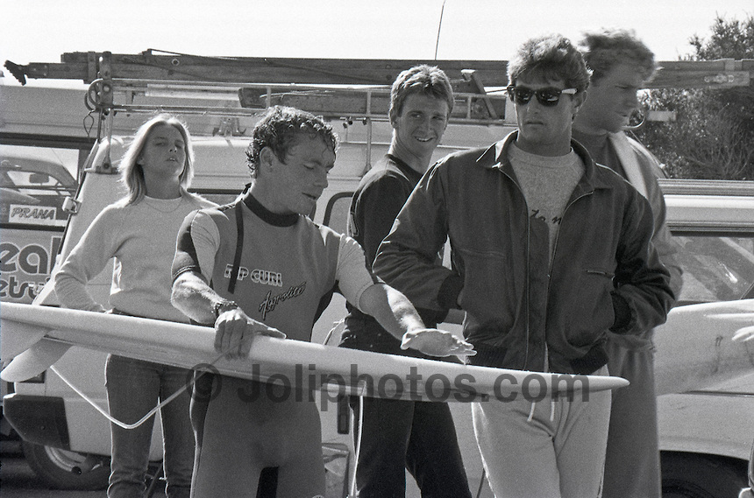
VCE Legal Studies 2017
The Constitution and the Protection of Rights Part 4
Rights in the Republic of South Africa.
A COMPARISON WITH THE COMMONWEALTH OF AUSTRALIA.
1977 BELL’S BEACH PRO. THE MAN IN THE GLASSES IS SOUTH AFRICAN SURFER – SHAUN TOMPSON

Slide 2
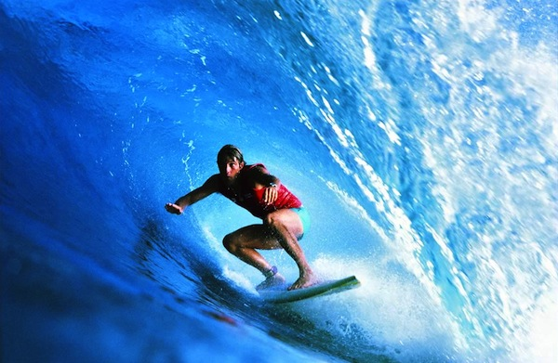
Shaun Tompson 1977
In 1977, South African cricket, rugby and soccer teams were banned from coming to Australia.
In 1977, the South African Government practiced a form of discrimination against the native born ‘Indigenous Africans’.
It was called apartheid.
In 1977 the beginnings of a professional world surfing tour were starting to take place.
An opponent of apartheid, South African surfer Shaun Tompson was welcomed here and competed at the Rip Curl Pro. This was largely unnoticed by the media.
Later in 1977, he became the first ISP World Champion. This would not
have been possible if he did not compete that year in Australia.

Slide 3
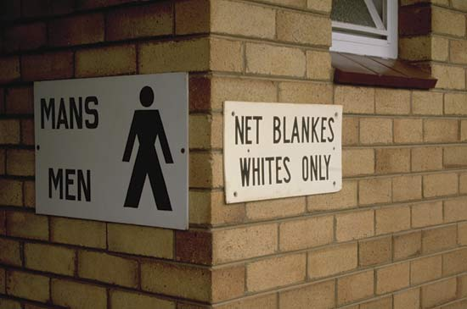
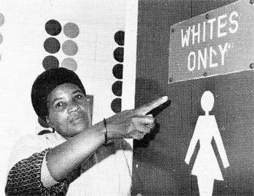
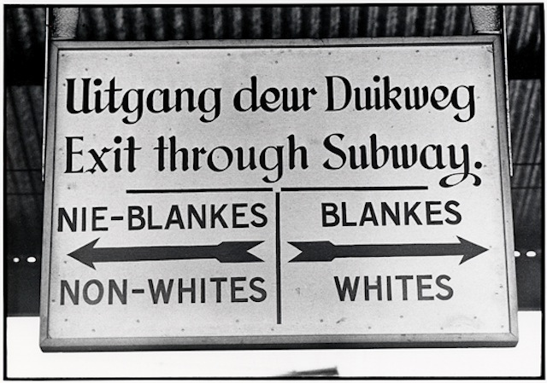
APARTHEID
Apartheid (Afrikaans pronunciation: [ɐˈpartɦɛit];
an Afrikaans word meaning "separateness", or "the state of being apart", literally "apart -hood") was a system of racial segregation in South Africa enforced through legislation by the South African National Party (NP), the governing party from 1948 to 1994
In 2016 it is hard to image what apartheid looked like.

Slide 4
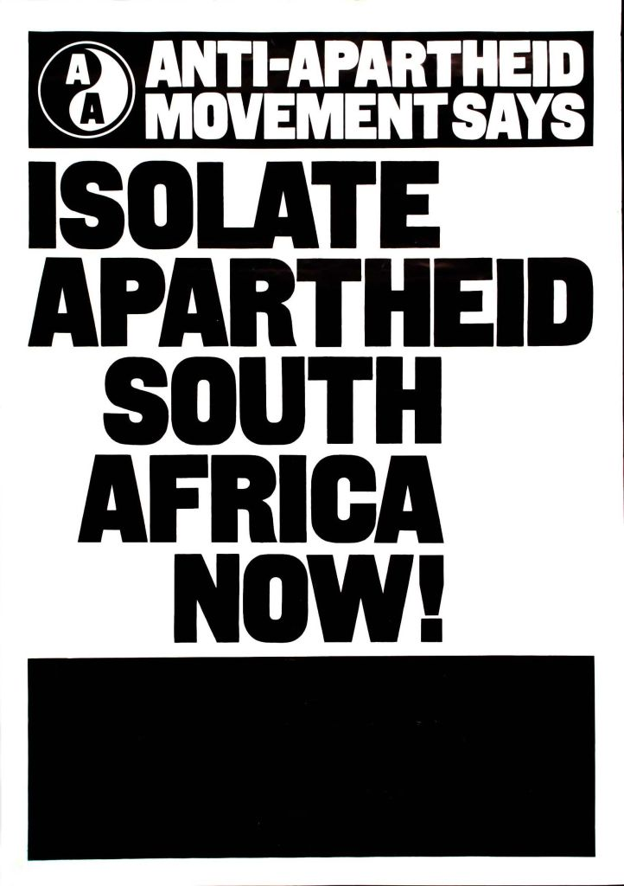
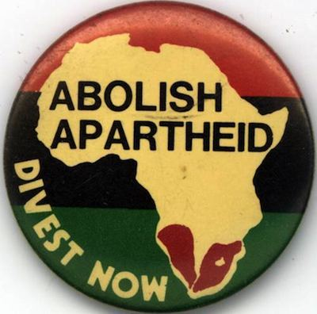
APARTHEID
For an ‘Indigenous African’, the years between 1948 to 1994 would have been a living hell in South Africa.
Australia felt so strongly about this we developed policies to block trade with South Africa called Anti-Apartheid policies.
Many countries also developed these policies and sport in South Africa was largely isolated from the rest of the world.

Slide 5
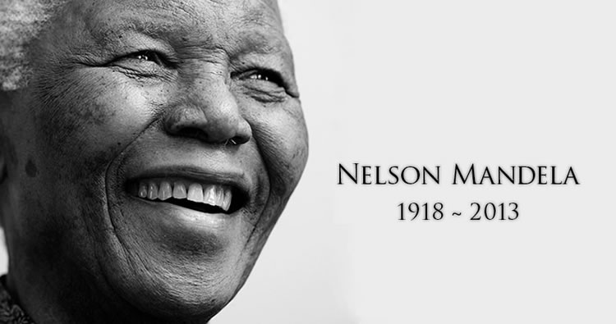
APARTHEID
Nelson Mandela
Opposed apartheid. Arrested and jailed in 1962
Spent 27 years in jail.
Many saw him as their spiritual leader. Waiting for him to lead them to freedom from apartheid.
An international campaign lead to his release in 1990.
Escalating violence and tension in South Africa in 1994 saw the government negotiate with Mandela to arrange the first Multi-Racial elections.

Slide 6
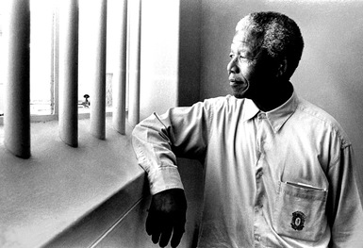
APARTHEID
Nelson Mandela 1994
In 1994 his ANC party was elected to government.
Mandela remained president from 1994 to 1999
Mandela arranged the new Constitution for South Africa.
WITH THIS HISTORY BEHIND US, SOUTH AFRICA NOW HAS THE MOST MODERN CONSTITUTION THAT WE CAN STUDY IN VCE LEGAL STUDIES.
AS AN ASSESSOR, I HAVE FOUND THIS COUNTRY THE BEST ONE TO COMPARE WITH AUSTRALIA IN CONSTITUTIONAL MATTERS.
You are the one who will make the decision on which country’s
Constitution you will specialise in.

Slide 7
The Constitution of South Africa
The Constitution of South Africa is the supreme law of the country of South Africa.
It provides the legal foundation for the existence of the republic, sets out the rights and duties of its citizens, and defines the structure of the government.

Slide 8
The Constitution of South Africa
Since 1996, the Constitution has been amended by seventeen amendment acts.
The Constitution is formally entitled the "Constitution of the Republic of South Africa, 1996.“
It was previously also numbered as if it were an Act of Parliament—Act No. 108 of 1996—but, since the passage of the Citation of Constitutional Laws Act, neither it nor the acts amending it are allocated act numbers.

Slide 9
Vital Information
DIFFERENCE BETWEEN OUR CONSTITUTIONS
Chapter Two of the Constitution of South Africa contains the Bill of Rights.
There is no Bill of Rights in Australia.
The South African Constitution contains a comprehensive list of rights. You would need to know specific examples of these or cases to show this difference. Eg equality, privacy, expression and human dignity.
Australia’s Constitutional protection of rights is not comprehensive. It is limited to 5 express rights.

Slide 10
Vital Information
DIFFERENCE BETWEEN OUR CONSTITUTIONS
A special feature of the South African Bill of Rights is its inclusion of economic, social and cultural rights.
Australia only has the 5 express rights.
South African Courts are required to interpret statutes in accordance with the Bill of Rights.
Remember, Australia does not have a Bill of Rights.
Finally, in SA, rights can be limited where justified in a free and democratic society. (Rights cannot be limited in Australia)

Slide 11
Vital Information
SIMILARITIES BETWEEN OUR CONSTITUTIONS
Both countries have rights that are entrenched in their constitutions. They can only be abolished if the constitution is amended.
Rights in both countries are fully enforceable. In South Africa, legislation that infringes any of their rights can be declared invalid by the Constitutional Court. (this is similar to Australia)
South African courts are to develop common law in accordance with the Bill of Rights. Similarly common law in Australia will need to comply with any constitutional requirements.

Slide 12
Practice Question – YOU TRY
Using one similarity and one difference, compare Australia’s constitutional approach to the protection of rights with the approach adopted by South Africa. 6 marks
12 minutes
Miss Horbach will hand out a word document with the question on it. Please answer it and hand in for grading.

Slide 13
What you need to know
Extract from the study design. This what you are expected to know:
Evaluate the means by which the Commonwealth Constitution protects rights, including structural protection, express rights, and implied rights
the significance of one High Court case relating to the constitutional protection of rights in Australia.
Comparison of Australia’s constitutional approach to the protection of rights and the approach adopted in one of the following countries: Canada, New Zealand, South Africa, or the United States of America.

Slide 14
What you must be able to apply
This is an extract from the assessment handbook. These are your performance descriptors for the next SAC and what may be on the exam.
Very thorough evaluation of the means by which the Commonwealth Constitution protects rights.
Sophisticated comparison of the approach to the protection of rights in a selected country, with Australia’s constitutional approach.

