Slide 1
Peter F Hughes ©
Legal Studies 2017
UNIT 3
CHAPTER FIVE
PART 1
The Role of the Courts

Slide 2
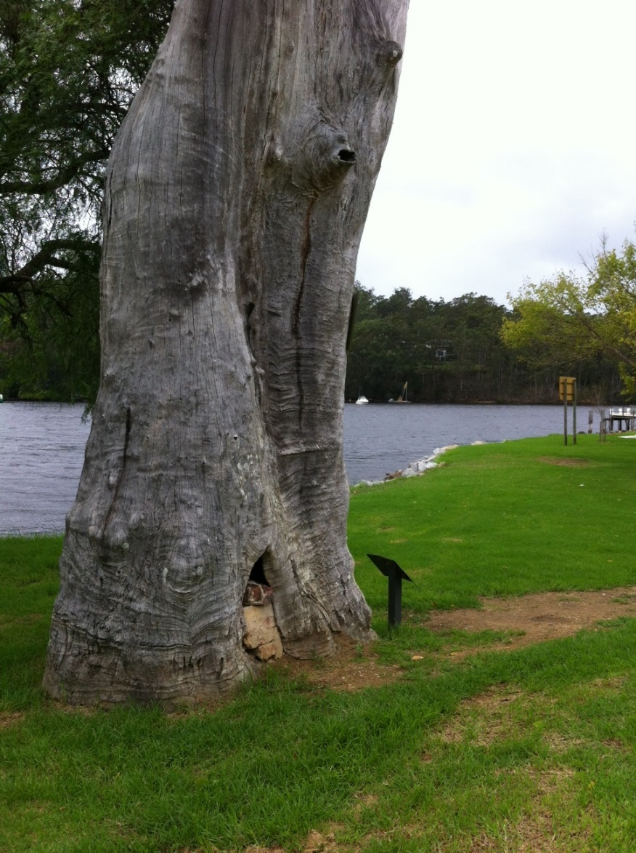
The Braidwood Tree
A QUIET TOWN CALLED NELLIGEN ON THE NEW SOUTH WALES SOUTHERN RANGES.
AN OLD TREE WITH SOME SCARS ON ITS BASE
A TINY PLAQUE TO REMIND US OF OUR HISTORY

Slide 3
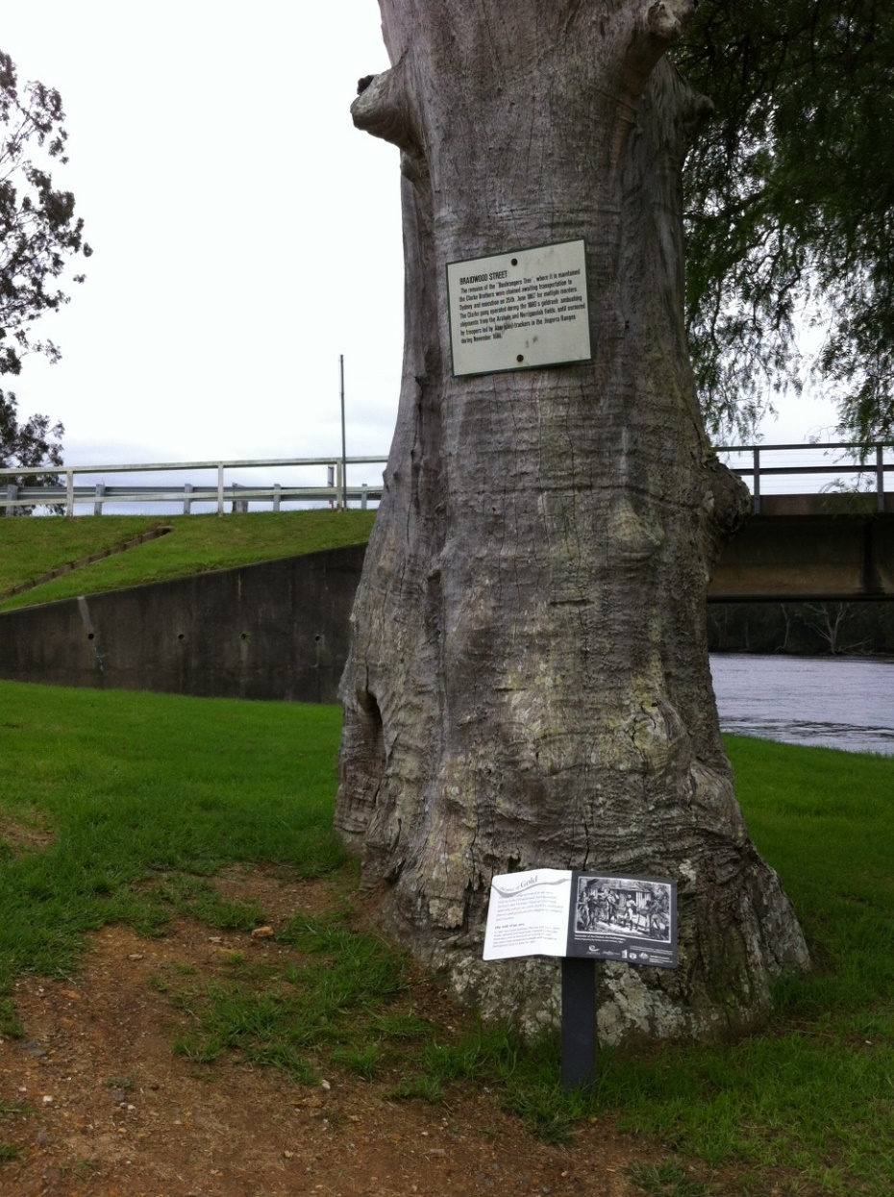

THE CLARKE BROTHERS
ON THE 15 FEBRUARY 1867 TOM AND JOHN CLARKE WERE CAPTURED BY NSW POLICE.
CHARGED WITH MURDER AND BUSHRANGING IN THE BRAIDWOOD DISTRICT.

Slide 4
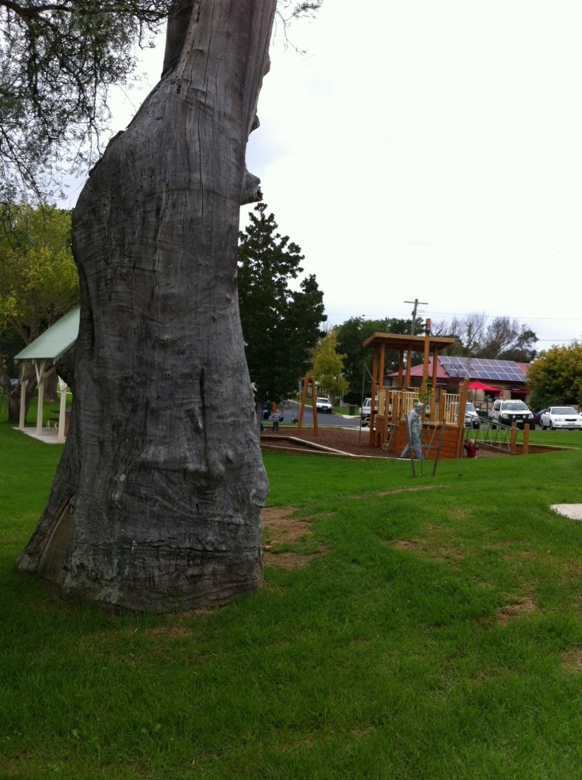
JUSTICE AND THE COURTS
THE BROTHERS WERE BROUGHT TO NELLIGEN AND SHACKLED TO THIS TREE FOR 3 DAYS BEFORE BEING BROUGHT TO SYDNEY.
THE CLARKE’S TRIAL LASTED ONE DAY.
It was stated in evidence that "when Thomas Clarke fired, John Clarke fired immediately afterwards ... with the intent to kill and wound the constables...".

Slide 5
Ratio Decidendi
The jury took 67 minutes to find both brothers guilty. Before passing sentence, Stephens pointed out that the Clarkes were to be hanged, not as retribution, but because their deaths were necessary for the peace, good order, safety and welfare of society.
Their fate was to serve as a warning to others. Stephens then pointed out the list of their offences over the previous two years.
Thomas: exclusive of the seven murders of which he was suspected, including that of Constable O'Grady, 9 robberies of mails, 36 robberies of individuals including Chinamen, labourers, publicans, storekeepers, tradesmen and settlers, John's offences in one year numbered 26 and his possible implication in the unexplained murder of the four specials. On 13 March 1865, the Araluen Gold Escort was attacked by the gang on the Majors Creek Mountain Road, and four troopers were shot dead. Two of the remaining troopers held off the attack and the gold was delivered to the Bank of New South Wales at Braidwood.

Slide 6
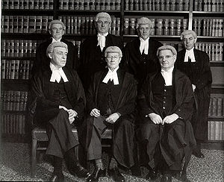
OUTCOME of this Part of UNIT 3
OUTCOME 3
Describe the Role and Operation of the Courts in Law-Making.
Evaluate the effectiveness of the courts as Law-Making Bodies.
Discuss the relationship of the courts with Parliament.

Slide 7
What can we expect in this Outcome?
An understanding of the courts and judges.
An excellent knowledge of the doctrine of precedent.
How judges use Statutory Interpretation.
The effect of their interpretation in our legal system.
The court’s strengths and weaknesses in law making.
The relationship between the courts and parliament in law-making.

Slide 8
Exam Technique
How can I improve the way I answer questions in the Law? (applicable to all)
Read chapter 5 before class.
Note each case and make case notes.
Follow up with the teacher on areas you are weak in.
Answer practice questions and hand them in for marking. (They can be emailed to hughes.Peter.f@edumail.vic.gov.au)

Slide 9
Exam Technique
This chapter comprises the last part of UNIT 3.
Your notes become important here as they will be set aside until late September.
Organise yourself now.
There is one lesson today on the introduction to the courts and law making.
Before you adjourn tonight ask yourself, ‘how can the teacher help me get better marks in law?’

Slide 10
Common Law
Judge made Law
Case Law.
It is quite simply a body of law that has developed over time through our association with the British Legal System.
The Braidwood tree is our link to a case that still has common law implications today.

Slide 11
Common Law
The Body of Law increases when a case is brought before the courts.
That case may contain facts that have never been heard before.
The Court’s reason for its decision becomes the law followed in future courts.

Slide 12
How a Court makes Law
A decision is made that a new issue is before the court.
A decision is made that an existing principle requires expansion in a new situation.
Statutory Interpretation – break this wording down. To look at and form an opinion / meaning of the words in an act of Parliament.

Slide 13
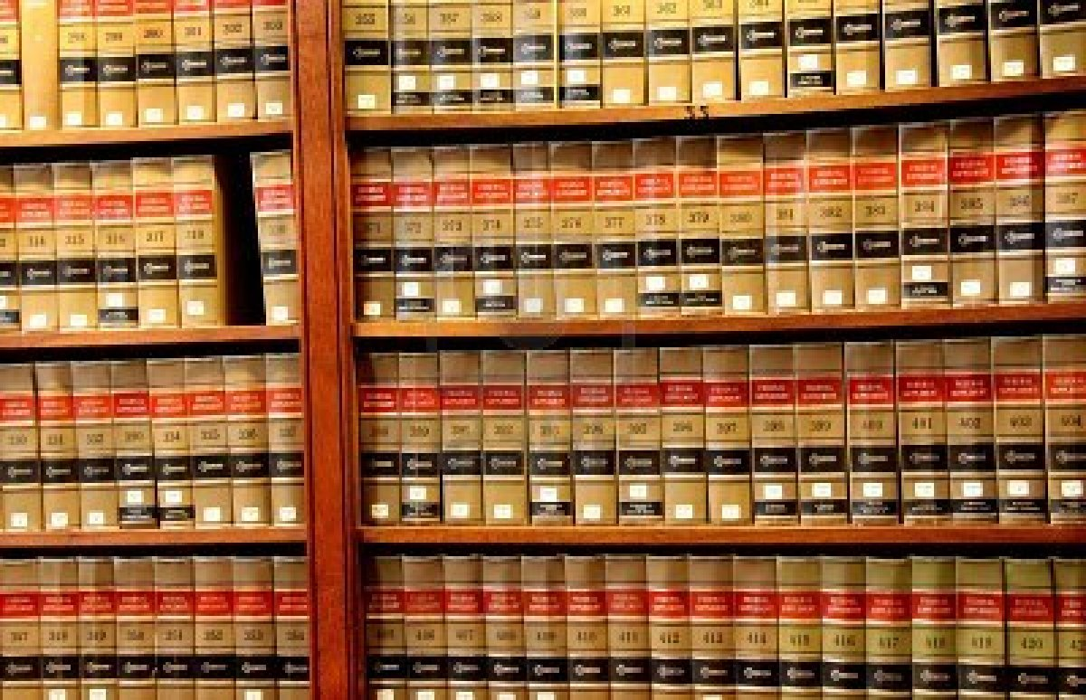
How a Court makes Law
The principal of law developed by a court that will be followed in future courts is the Ratio Decidendi. (reason for the decision)

Slide 14
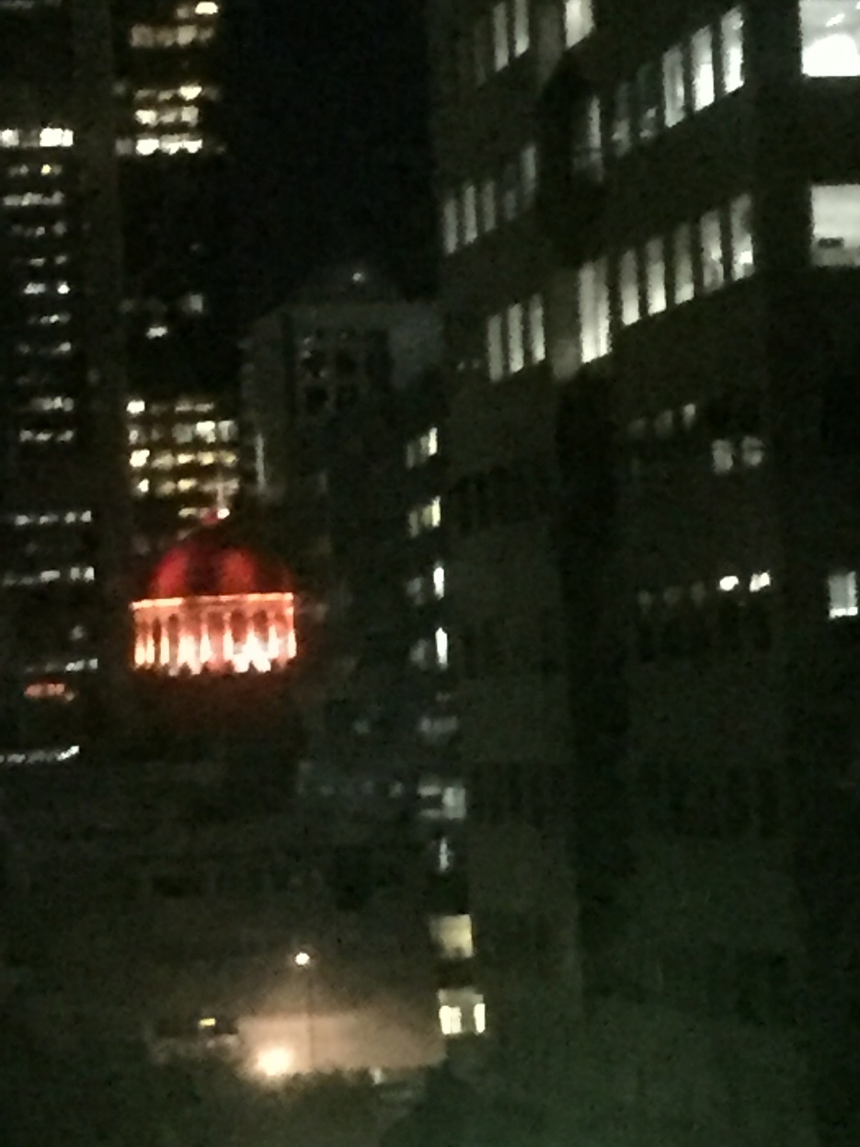
The Ability of our Legal System to keep up to date in modern times.
Common Law
Builds on existing law.
Provides a modern interpretation of what the law means today.
Expands our legal system.

Slide 15
Restrictions to judge-made law.
The case must be brought before a superior court.
Eg: The Supreme Court is hearing a case on appeal from a lower court.
The person bringing the case has lost it in a lower court (County Court).
Expensive process.

Slide 16
Restrictions to judge-made law.
Law principals established in higher courts are binding on lower courts.
Binding means they are followed.
However:
If there is no previous binding decision in a higher court there may be an opportunity to establish a new principal of law.
It must be shown there are distinguishing differences.

Slide 17
The Doctrine of Precedent
Doctrine = A principle of religious or political belief.
Precedent = Previous cases taken as a guide for subsequent cases or as justification.

Slide 18
The Doctrine of Precedent
Always an examination question
How it operates:
Judges stand behind the decision of previous judges.
When a new situation arises, precedent created.

Slide 19
The Doctrine of Precedent
Example:
Law of Victoria states that Genetically Modified (GM) Canola cannot be planted in Victoria. (2007)
In 2010 a farmer brings samples of a GM seed into Australia after attending a GM forum in Europe.
He plants a small trial plot on his farm at Woomelang in the Mallee.
Birds eat the seed and it spreads to a neighbor’s farm and is discovered growing there 6 months later.

Slide 20
The Doctrine of Precedent
Case is before Supreme Court of Victoria.
Decision – Guilty. Farmer brought in the seed and planted it. (fine and damages awarded)
Ratio – The farmer owed the entire farming industry a duty of care to keep our crops free from genetically modified seed.

Slide 21
The Doctrine of Precedent
2012
Another farmer buys some Canola seed from Mansanto Ltd, a large supplier of organic grain seed in Australia.
Truck arrives from NSW with the seed and the farmer plants 3,000 hectares with the it.
6 months later his crop is flowering and in seed. It accidentally spreads to neighbor’s farm.

Slide 22
The Doctrine of Precedent
2012
This farmer notices his Canola looks strange. Has it tested and finds it is GM Canola. Advises his neighbour that GM Canola has spread to his property.
Department of Primary Industries closes both farms and charges the farmer under the Victorian ACT.

Slide 23
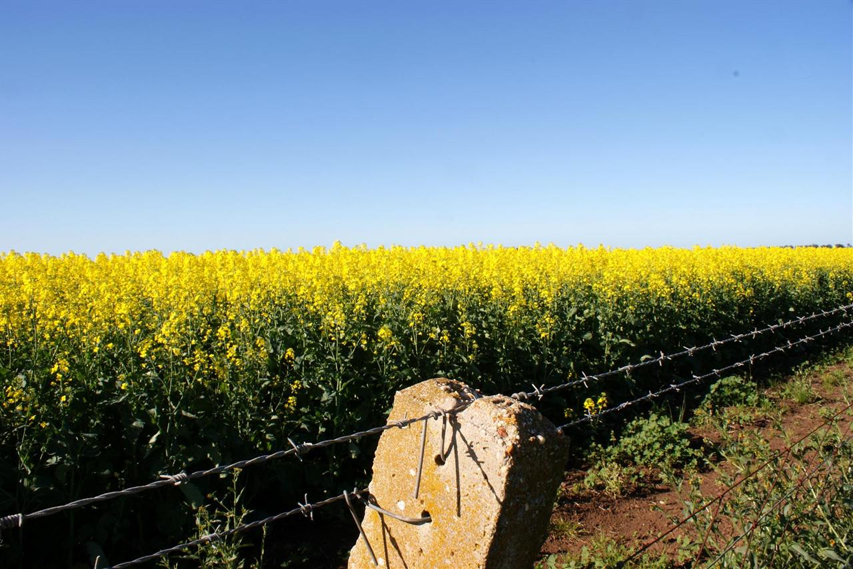
The Doctrine of Precedent
2012
Case comes before the Supreme Court of Victoria.
Result?
What will happen now?
What do you think?

Slide 24
The Doctrine of Precedent
The Ratio from the previous case will apply as the same court will hear the new case.
Ratio – The farmer owed the entire farming industry a duty of care to keep our crops free from genetically modified seed.
However, Monsanto provided the seed and it owed a duty of care to the farmer to supply GM free seed.

Slide 25
The Doctrine of Precedent
Confusing?
By the time we have completed precedent you will have formed an opinion on the GM crop case.
Your opinion will be based on your knowledge of the 4 ways that precedent is handled and case law surrounding it.

Slide 26
The Doctrine of Precedent
CASE LAW
Is becoming important now.
I suggest you make a summary of the important cases in this topic and get ready for September.
Let us begin

Slide 27
How the Doctrine of Precedent Operates
Law making generally happens in Courts of Appeal.
Jury Trials do not create precedent.
Judges alone create it.
Judges alone in their ruling talk about ‘Points of Law’
This normally occurs at the end of the case.

Slide 28
Stare Decisis
Stand by the Decision
A principle that lower courts will stand by the decision of higher courts

Slide 29
Ratio Decidendi
The reason for the decision
Not the decision itself but the reason for the decision.
Eg: To keep Victoria free from GM Crops farmers owe the industry a duty of care.
Lets roll with the case law (I warned you!)

Slide 30
Shaddock v Parramatta CC (1981)
Facts: Shaddock received incorrect advice from the council about land development.
Shaddock based his investment decision on that advice. Council reneged on permit.
Shaddock sued for negligent advice.
Decision: Found in favour of Shaddock. He based his investment decision on the advice.
Ratio: The duty of care is on the Council who knew his investment was based on their advice.

Slide 31
Ratio Decidendi
Find the material facts of a case and summarise them.
Material facts are vital to the reasoning in the case (Reason for the decision)
It is the ratio decidendi and the material facts that are considered when deciding cases in the future.

Slide 32
Ratio Decidendi
Ever wondered what all the volumns of law books are in a lawyers chambers?
They are case law and
Law journals which summarise cases.
Ratio Decidendi of a case may be explained more clearly in a later case that considers it and then uses it in binding precedent.

Slide 33
Binding Precedent
Must be from the same hierarchy of courts.
Can be from a superior court (higher in authority)
High court not bound by previous decisions but follows them unless it isn’t good law.
High court looks at outdated matters eg technology, circumstances or change in society’s attitudes (Lets not go there)

Slide 34
Persuasive Precedent
Not binding on lower courts.
Are noteworthy though and have high regard.
Can be from overseas courts
Eg International law matters like internet law etc
Can be from courts on a lower level.
Obiter Dictum – other information contained in a judgement that may bring relevance to the Ratio.

Slide 35
Persuasive Precedent
Your turn
Summarise these cases:
Donoghue v Stephenson (1932) page 196
Grant v Aust Knitting Mills (1936)
Hedley Byrne & Co Ltd v Heller (1964)

